Slide 1

Adaptive Cards
Community call
Teams Toolkit v4.0🆕
Live App Demo
Q&A ❔
J.P. Roca Microsoft
June 09, 2022

Slide 2
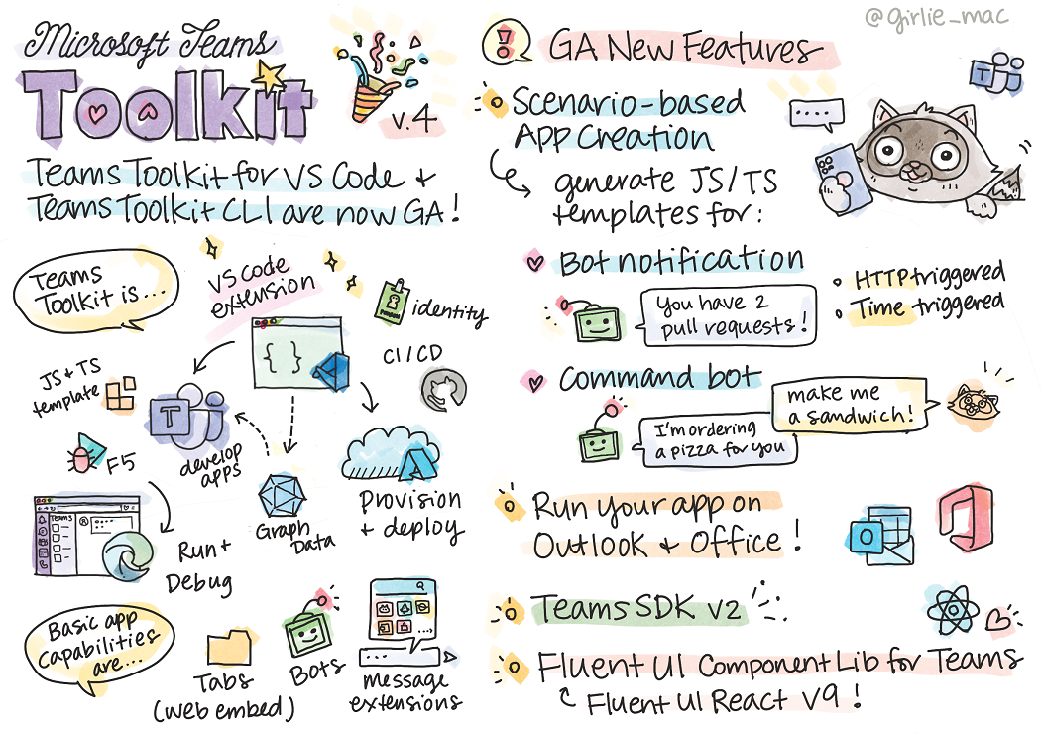
Microsoft Teams Toolkit for Visual Studio Code now generally available - Microsoft 365 Developer Blog

Slide 3
Prerequisites
Teams Toolkit
Microsoft Teams
Node.js
A browser with developer tools
Visual Studio Code

Slide 4
Demo
Notes:
I wanted to give you all a recap on Viva Connections, and how the Adaptive Card framework plays a big role in the extensibility world of Viva Connections, for both 1P and 3P components and how the devs can use that to extend VC experience in the dashboard.

Slide 5
Learn More
http://aka.ms/TeamsAppJS
Teams Toolkit Overview - Teams | Microsoft Docs
Get started - Overview - Teams | Microsoft Docs
Microsoft Teams Toolkit for Visual Studio Code Blog
Tomomi Imura (@girlie_mac) / Twitter

Slide 6
Q&A

Slide 7
Resources
Let us know the features you need https://aka.ms/ACRoadmap
Get started with Templating https://aka.ms/ACTemplating
Browse the Adaptive Cards Code https://aka.ms/ACRepo
Find tools, sample cards and more https://www.madewithcards.io

Slide 8
Microsoft 365 developer community calls
Microsoft 365 platform call (weekly) https://aka.ms/m365-dev-call
Adaptive Cards (monthly) https://aka.ms/adaptivecardscommunitycall
Microsoft identity platform (monthly) https://aka.ms/IDDevCommunityCalendar
Office Add-ins (monthly) https://aka.ms/officeaddinscommunitycall
Power Apps (monthly) https://aka.ms/PowerAppsMonthlyCall
Microsoft 365 Community (bi-weekly) https://aka.ms/m365-dev-sig
SharePoint Framework (bi-weekly) https://aka.ms/spdev-spfx-call
https://aka.ms/m365pnp

